Slide 1

Critical Screening in the Yukawa Atom
UGP Presentation (PHY556)
Adityaa Bajpai (150056)
Advisor: Prof. Manoj K Harbola

Slide 2

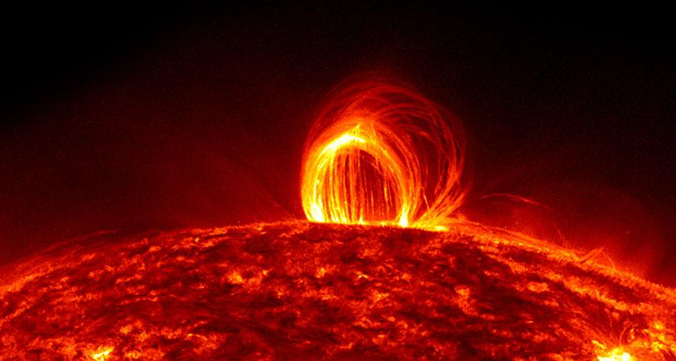
Yukawa Atom : Physical Inspiration
e⁻
Electron Cloud

Slide 3
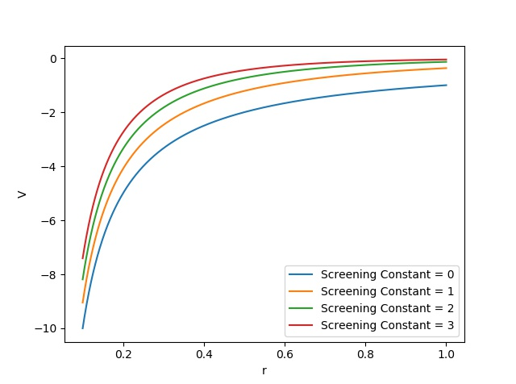
Yukawa Atom : Potential
e⁻
V=-Z exp(−λr)/r

Slide 4
Yukawa Atom
As the screening constant (λ) is increased the potential becomes more and more confining and its strength at a point keeps decreasing
V=-Z exp(−λr)/r
Therefore we expect that at some particular λ the e⁻ has to become unbound: hence the term Critical screening (λ_{c})

Slide 5
One-electron Yukawa Atom

Slide 6
Numerov’s Algorithm
For an equation : d²𝝍/dx²=f(x) 𝝍
𝝓 _{k+1}= 2 𝝓_{k} - 𝝓_{k-1} + h² f_{k}𝝍_{k}
𝝓_{k}= 𝝍_{k}(1-(1/12)h² f_{k})
In our case f=2[V(r) - E_{n}] (for ground state l=0)

Slide 7
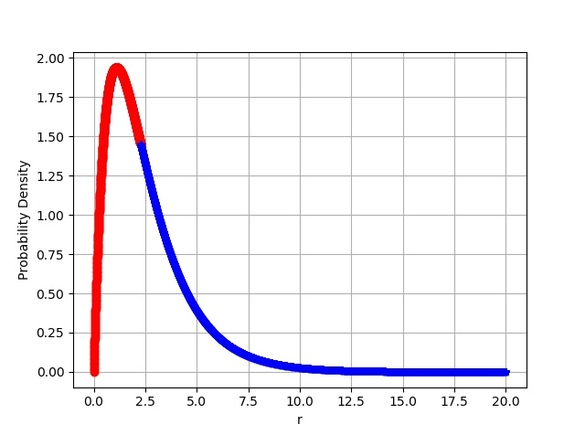
Numerov’s Algorithm
Since 𝝌=r R_{nlm}(r), it goes to zero at r=0 and r=r_{max}
Solution from the front
Solution from the back
We start building the solution from both the sides
We compare the slope of the two solution at an intermediate point

Slide 8
Numerov’s Algorithm
The Energy E_{n} is varied until the difference in the slope goes below a certain tolerance (10⁻¹²)
We don’t worry about the continuity since both the solutions can be rescaled to attain that

Slide 9
Two-electron Yukawa Atom

Slide 10
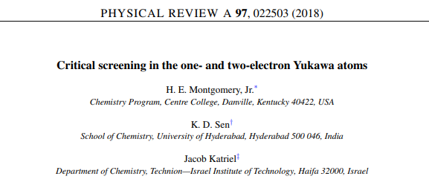
Existing Work
Two electron Yukawa atom has two critical screening constants
The first when only one electron becomes unbound (λ₂) and the second when the left out electron is also unbound (λ₁)

Slide 11
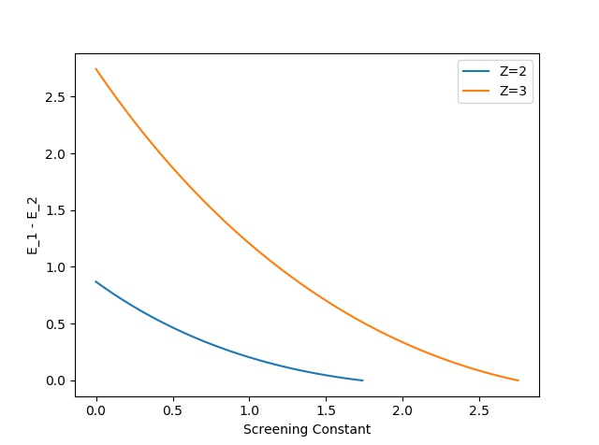
Existing work
λ₂ is obtained by observing E₁- E₂
As the screening constant approaches λ₂ this quantity goes to zero
λ₁ can be found fairly easily by the method discussed for one -electron Yukawa atom

Slide 12
Existing Work
E₂ is Variationally obtained using the Hyllera’s wave function.
𝛙_{hyllera}=exp(−αs)∑s^{l} t^{m} u^{n} , where s=r₁+r₂
u=r₁₂ and t=r₂-r₁
This is a very tedious method, though it gives very accurate results.

Slide 13
Other Candidates
We considered two more wave function to variationally obtain E₂ and hence λ₂
𝛙_{Zeff}=C_{n}e^{-Zeff(r1+r2)}
𝛙_{CS}=C_{n}{exp(-[Z₁r₁+Z₂r₂])+exp(-[Z₂r₁+Z₁r₂])}

Slide 14
Results
 |  | 𝛙_{Zeff} | 𝛙_{CS} | 𝛙_{hyllera}
Z | λ₁ | λ₂ | λ₂ | λ₂
1 | 1.1867 | Not Bound | 0.5947 | 1.125
2 | 2.3665 | 1.4238 | 1.7369 | 2.30
3 | 3.5556 | 2.4265 | 2.7507 | 3.48
4 | 4.732 | 3.3922 | 3.7541 | NA

Slide 15
Conclusion
The results show clearly that the two wave functions we considered are not very useful for estimating the two-electron ground state energy
Notice a pattern in λ₂ values:
𝛙_{Zeff} < 𝛙_{CS} < 𝛙_{hyllera}

Slide 16
Conclusion
This pattern is also visible in the ground state energy values of He computed using these wave functions
𝛙_{Zeff} | 𝛙_{CS} | 𝛙_{hyllera}
-2.847656 Hartree | -2.8756610532 Hartree | -2.9037 Hartree*
*http://www.chem.unt.edu/~mschwart/chem5210/Files/Hdout-Chap-7-5210.pdf

Slide 17
Conclusion
These pattern in the critical screening constants can be explained by the boundedness of the three wave functions
This leads us to our prospective wavefunction : Le Sech wave function
𝛙_{Le Sech}=exp(-Z(r₁+r₂))[Cosh(ar₁)+Cosh(ar₁)]{1+0.5 r₁₂exp(-b r₁₂)}

Slide 18
Conclusion
The energy of He calculated through Le Sech’s wavefunction lies in between those of Chandrashekhar and Hyllera’s.
𝛙_{Zeff} | 𝛙_{CS} | 𝛙_{Le Sech} | 𝛙_{hyllera}
-2.847656 Hartree | -2.8756610532 Hartree | -2.9020 Hartree* | -2.9037 Hartree
*Improved Le Sech wavefunctions for two-electron atomic systems Rabeet Singh Chauhan Manoj K.Harbola

